Slide 1
NLP Toolkit
ETL, Document Summarization, PII detection
and sentiment analysis.
Version 1 : 2022-09-02

Slide 2
NLP Toolkit
Functions
Agenda:
ETL function
Sentiment analysis
Document summarization
PII detection
Notebook link:
Databricks:
All_functions_import_test - Databricks (azuredatabricks.net)
GitHub repo:
ssc-dsai/nlp-exploration-notebooks (github.com)

Slide 3
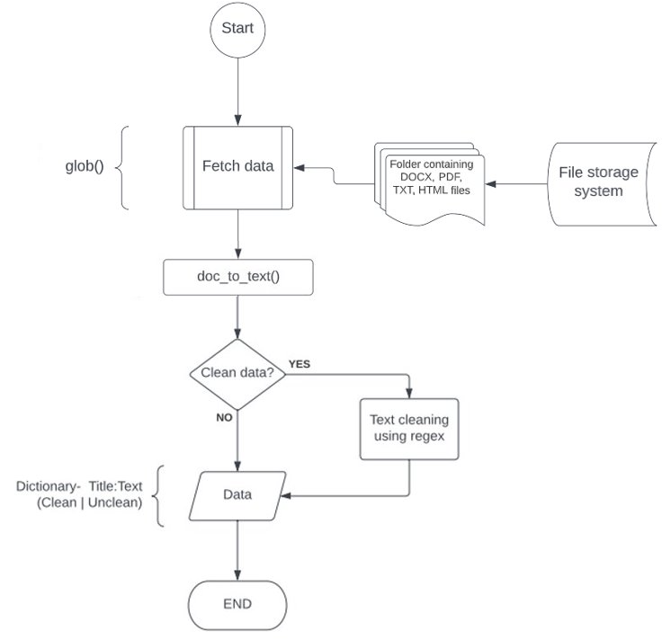
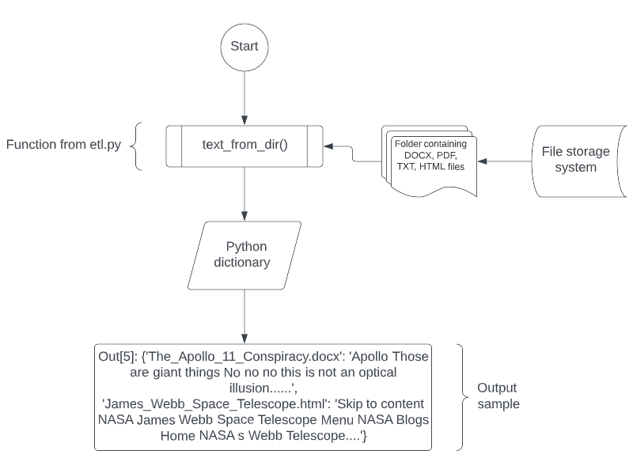
ETL – Docx, pdf, html, txt.
ETL function
ETL process flowchart:
1)
2)

Slide 4
Sentiment analysis using pre-trained deep learning models
Function execution
Model name: distilbert-base-uncased-finetuned-sst-2-english · Hugging Face​
Sample data:
Observations: ​
This model has a binary output: Positive | Negative sentiments. It performed as expected. ​
​Published benchmark evaluation results: Accuracy of 91.3​
For detailed results, please visit: distilbert-base-uncased-finetuned-sst-2-english · Hugging Face ​
File name | File size | Execution time
The_Apollo_11_Conspiracy.docx | 14.5 kb | 441 words | 0.32 seconds
James_Webb_Space_Telescope.html | 100 kb | 6328 words | 2.49 seconds

Slide 5
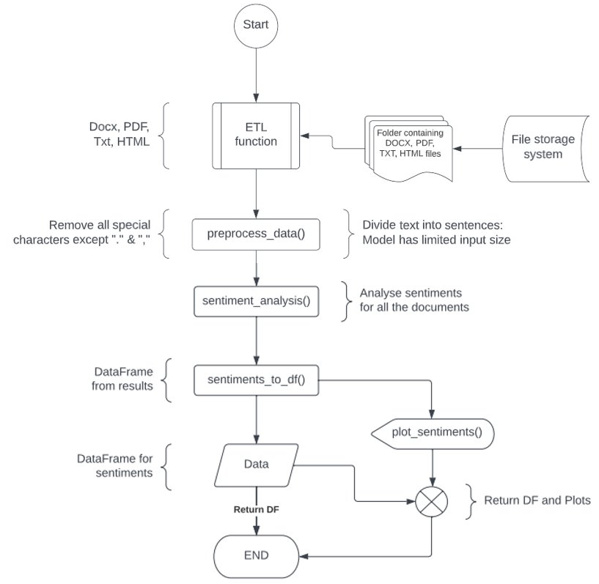
Sentiment analysis using pre-trained deep learning models
Sentiment analysis function
Sentiment analysis flowchart:

Slide 6
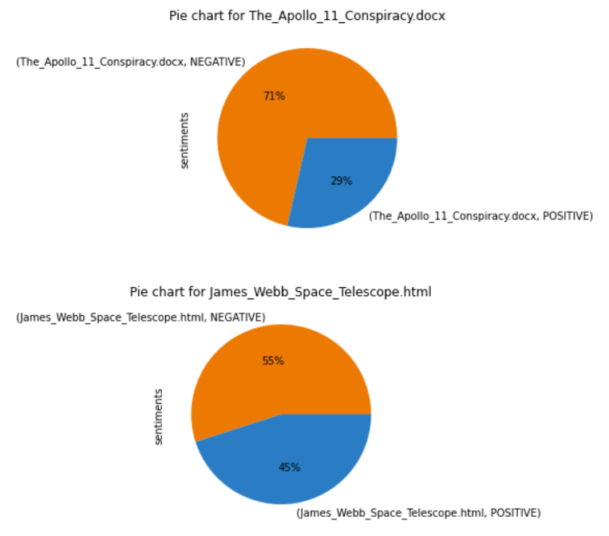
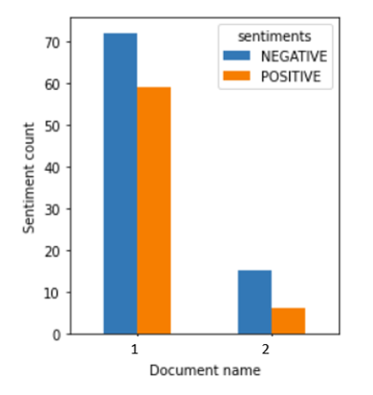
Sentiment analysis using pre-trained deep learning models
Function output
Plots: distilbert-base-uncased-finetuned-sst-2-english · Hugging Face

Slide 7
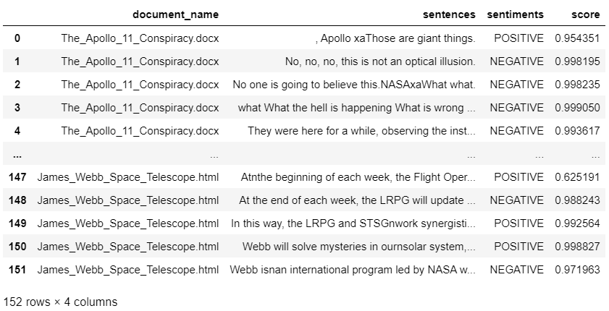
Sentiment analysis using pre-trained deep learning models
Function output
Data frame: distilbert-base-uncased-finetuned-sst-2-english · Hugging Face

Slide 8
Sentiment analysis using pre-trained deep learning models
Function execution
Model name: nlptown/bert-base-multilingual-uncased-sentiment · Hugging Face​
Sample data: ​
Observations: ​​
This model has 1-to-5-star rating output: 1 Star being the most negative. 5 Star being the most positive. Please visit: nlptown/bert-base-multilingual-uncased-sentiment · Hugging Face
Roughly 2x slower than the first model.
File name | File size | Execution time
The_Apollo_11_Conspiracy.docx | 14.5 kb | 441 words | 0.56 seconds
James_Webb_Space_Telescope.html | 100 kb | 6328 words | 5.43 seconds
Language | Accuracy (Exact) | Accuracy (Off-by-1)
French | 59% | 94%
English | 67% | 95%

Slide 9
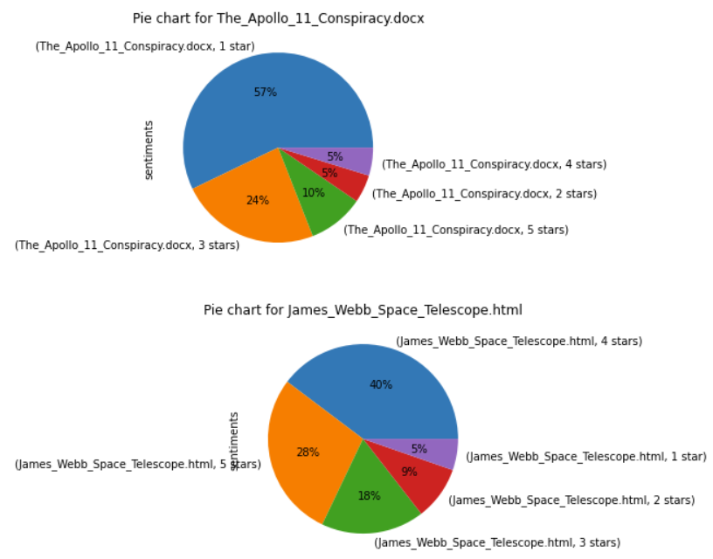
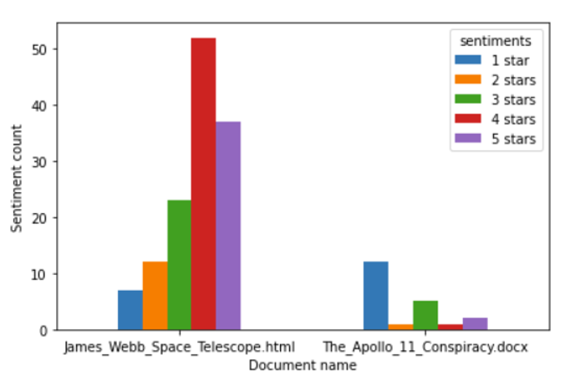
Sentiment analysis using pre-trained deep learning models
Function output
Plots: nlptown/bert-base-multilingual-uncased-sentiment · Hugging Face

Slide 10
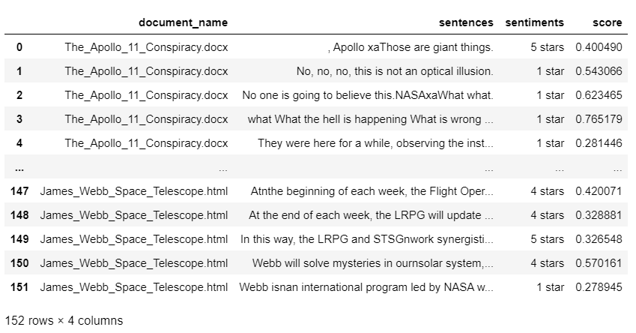
Sentiment analysis using pre-trained deep learning models
Function output
Data frame: nlptown/bert-base-multilingual-uncased-sentiment · Hugging Face

Slide 11
Document summarization using pre-trained deep learning models
Function execution
Model name: knkarthick/MEETING_SUMMARY · Hugging Face
Sample data:
File name | File size | Execution time
2021-08-23 Doris Paquin (Spectrum) meeting notes.docx | 30kb | 769 words | 5.20 seconds
ICT-ACR meeting notes 2020-11-12.docx | 17kb | 796 words | 5.82 seconds
2020-11-16 GSA USAB meeting notes.docx | 19kb | 1364 words | 10.81 seconds
ebidm-dsai meeting notes 2022-01-21.docx | 37kb | 1140 words | 9.10 seconds
2022-06-15 Onyx demo from Curtis ONeil.txt | 3kb | 349 words | 2.96 seconds
2021-10-15 ESD assumptions meeting notes.txt | 3kb | 411 words | 2.03 seconds

Slide 12
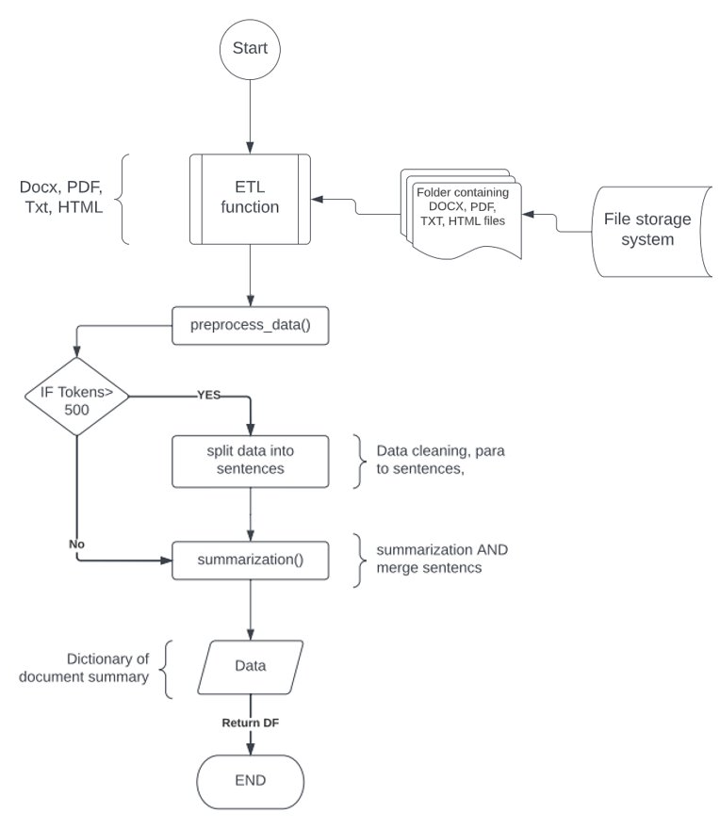
Document summarization using pre-trained deep learning models
Summarization function
Summarization flowchart:

Slide 13
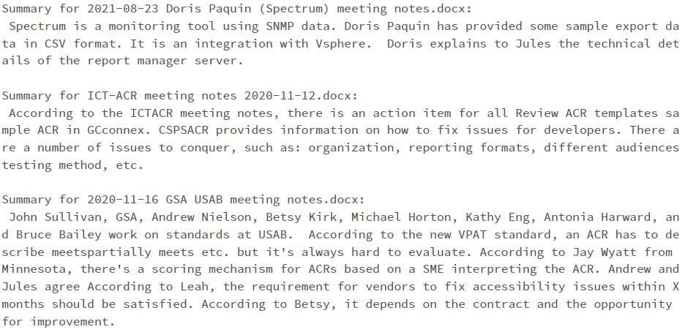
Document summarization using pre-trained deep learning models
Function output
Summarization output: knkarthick/MEETING_SUMMARY · Hugging Face

Slide 14
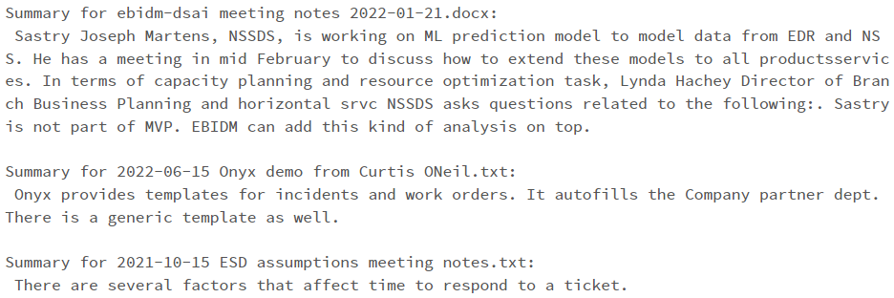
Document summarization using pre-trained deep learning models
Function output
Summarization output: knkarthick/MEETING_SUMMARY · Hugging Face

Slide 15
Document summarization using pre-trained deep learning models
Function execution
Model name: knkarthick/MEETING_SUMMARY · Hugging Face
Summary for a "non-meeting" document:
File name​ | File size​ | Execution time​
James_Webb_Space_Telescope.html​ | 100 kb | 6328 words​ | 5.43 seconds​
'James_Webb_Space_Telescope.html': " The commissioning activities for NASAs James Webb Space Telescope fornscience have been completed. All of the seventeen scientific instruments have now been checked out. The NearInfrared Spectrograph, or NIRSpec, is ready for science operations. NIRCam, or the NearInf The final mode verified for NIRSpec was the multiobject spectroscopy mode, which allows it to capture spectra from hundreds of different cosmic targets at once. It will be used to characterize everything from the faintest objects in the universe to the formation of galaxies and star clusters. The James Webb Space Telescope will be launched next week. It will be a great tool for astronomers to explore space and study the universe. The next great observatory will be built after Webb. The James Webb Space Telescope is getting ready to launch. Recently it captured one of the deepest images of the universe ever taken by the telescope. The first image from the James Webb Space Telescope was taken during an engineering test. It shows faint galaxies that Webb will study in its first year of science operations. The James Webb Space Telescope will release its first fullcolor images andnspectroscopic data on July. The Canadian Space Agency's contribution to the James Webb Space Telescope is ready for scientific operations. NIRISS, the instrument that will probe exoplanets' atmospheres, will start collecting data on July 1st. The NIRSpec Grating Wheel Assembly GWA is used to separate the wavelengths of incoming lightninto a spectrum. It is also used to acquire targets and place them at the proper locations in the instrument. The James Webb Space Telescope team continues to work through the science instrument modes. This week they checked off numbers NIRCamngrism time series and imaging time series, both used to study exoplanets, NIRISS aperture masking interferometry, for direct detection of a The MIRI team has been working on the spectral bands of the MRS. They have been focusing on aligning the imagingncomponents of the instrument. The team is now in the last phase of commissioning the science instruments. The first two instrument modes, NIRCam The James Webb Space Telescope is about to transition from commissioning to regular operations. During regular operations, the telescope will focus on scientific observations. The James Webb Space Telescope is a project of the National Aeronautics and Space Administration."}

Slide 16
PII detection using Presidio analyzer-AnalyzerEngine
Function execution
API: Presidio analyzer - Microsoft Presidio
Sample data
File name | File size | Execution time
2021-08-23 Doris Paquin (Spectrum) meeting notes.docx | 30kb | 769 words | 0.11 seconds
2020-11-16 GSA USAB meeting notes.docx | 19kb | 1364 words | 0.18 seconds
ebidm-dsai meeting notes 2022-01-21.docx | 37kb | 1140 words | 0.18 seconds
2022-06-15 Onyx demo from Curtis ONeil.txt | 3kb | 349 words | 0.06 seconds
Observations: ​​
Presidio does not detect dates. Had to use a different date parser to process the dates.
Date parser: ishirav/date-detector: A Python module for scanning text and extracting dates from it, regardless of language or date format (github.com)

Slide 17
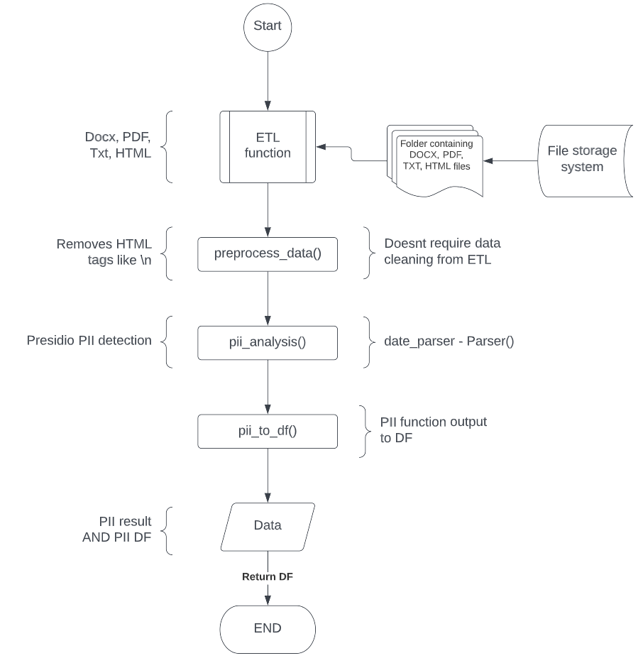
PII detection using Presidio analyzer-AnalyzerEngine
PII detection function
PII detection flowchart:

Slide 18
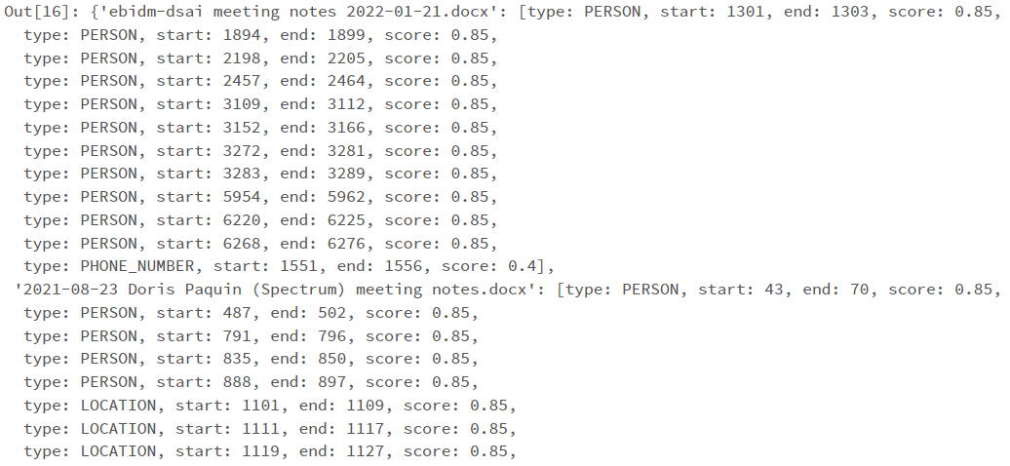
PII detection using Presidio analyzer-AnalyzerEngine
Function output
Presidio analyzer output:

Slide 19
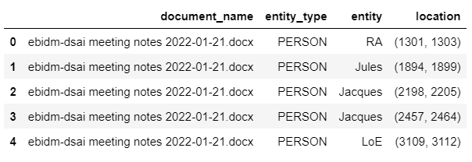
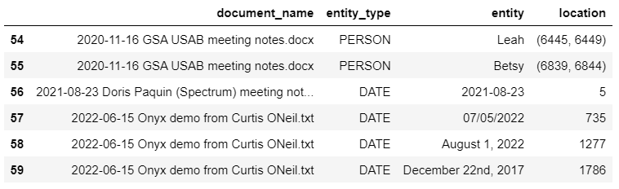
PII detection using Presidio analyzer-AnalyzerEngine
Function output
PII DataFrame:

Slide 20
Thank you

